Slide 1

The LANLords
Ben Dunkin
Tyler Delk
Brody Owen

Slide 2

Scenario
The HO HO HO Company is requesting a comprehensive solution to design, install, and secure an IT infrastructure for the "Toy Design Department", specifically for:
Room 124: Main work area with cubicles and team tables
Room 124A: IT Services Room (server and cable terminations)
Room 123: Meeting/Work Room
Room 122: Executive Suite
Room 125: Secure Compartmented Information Facility (SCIF)

Slide 3
^
^
^
^
^
^
^
^
^
^
^
^
^
^
^
x
x
x
x
x
x
x
x
x
x
x
x
x
x
x
v
Worker Cubicles
v
Cable Tray in Ceiling
Net
^
Team Lead Cubicles
Rack
^
^
^
^
^
x
x
x
x
x
x
^
v
Cable Tray in Ceiling
v
Work Tables
x
x
x
x
x
v
^
^
^
^
^
Room 124A - Servers
In Floor Comm (Top)
& Power (Bottom)
Room 124 and 124A
Blue Line – Ethernet
Pink Line – Antenna Cable
“x” – Ethernet Connections
“^” – Cable Up
“v” – Cable Down
Total Room Dimensions: 60' x 32'
Room 124A Dimensions: 8' x 24'

Slide 4
Room 123A – Storage
Printer A
Wi-Fi Antenna
x
^
v
v
Cable Tray in Ceiling
v
Work Tables
Work Tables
^
x
IT Workstation
x
Console Patch
Room 123B – IT Closet
^
x
Printer B
Wi-Fi Antenna
Room 123,123A & 123B
Blue Line – Ethernet
Pink Line – Antenna Cable
“x” – Ethernet Connections
“^” – Cable Up
“v” – Cable Down
Orange Dashed Line – Area of Wi-Fi Coverage
R123 Room Dimensions: 40'x 32'
R123A Room Dimensions: 12' x 16'
R123B Room Dimensions: 12' x 16'

Slide 5
Network Topology - overall
Mesh-star hybrid

Slide 6
Network Topology - routers
Internet
Root Router
Room 123 Router
Room 124 Router
Room 124A Router

Slide 7
Network Topology - room 123
Root Router
Room 123 Wireless Router
Room 123 Router
Room 123 IT Closet Switch
Room 123 Printers Switch
IT PC
Printer A
Printer B

Slide 8
Network Topology - room 124
Root Router
Room 124 Router
Room 124 Worker Cubicles Switch
Room 124 Team Leads Switch
Room 124 Worktables Switch
PCs A-O
PCs P-U
PCs V-Z

Slide 9
Network Topology - room 124A: Servers
Root Router
Room 124 Servers Switch
Room 124 Router
File Server
Web Server
SQL Server

Slide 10
SQL Server Hardware Specs
CPU: 12-24 cores, 2.5-3.5 GHz clock speed
RAM: 128-256 GB
Storage: Minimum 4TB
Power Supply: 750W+
NIC: 10GbE or higher
Cooling: High Performance Air cooling / AIO Liquid

Slide 11
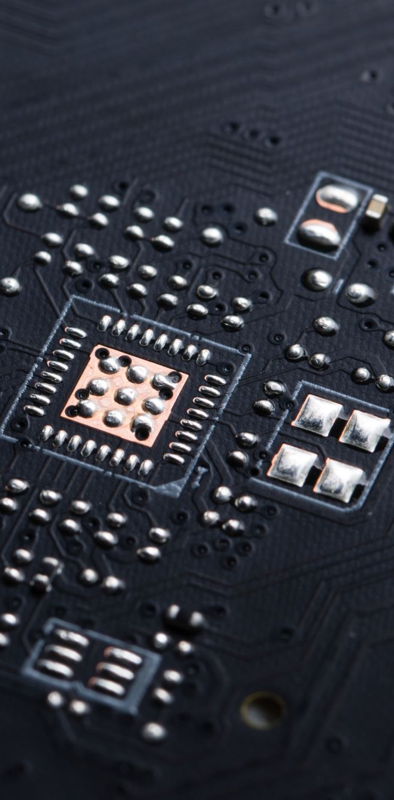
SQL Hardware
CPU: x64 multi-core processor, Intel Xeon 6724P Processor, 16 total cores, 4.30 GHz Max Turbo Frequency, 3.60 GHz Processor Base Frequency, 72 MB Cache, 210 W TDP
RAM: Kingston FURY Beast Black 128GB (4x32GB) 5600MT/s CL40 DDR5 XMP DIMM
Storage: Intel DC P4610 6.4TB PCIe NVMe MU 2.5'' SSD SSDPE2KE064T8T Dell DP/N: 092F30
Network Interface Card: Intel X722-DA4 10GbE PCIe Network Adapter Card
Cooling: Noctua NH-U12A (CPU Cooler), Noctua NF-A12x25 (High-Performance Fan)

Slide 12

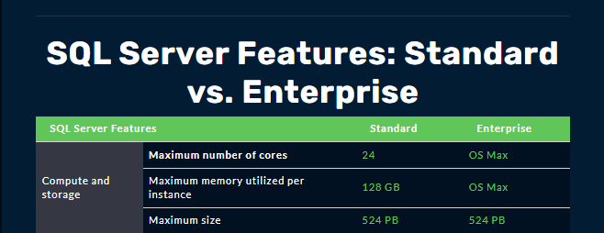
SQL Server Example
Microsoft SQL Server 2022 Enterprise Edition can meet the standards for the hardware specifications

Slide 13
Apache Web Server
Web Server will be installed on a dedicated internal server located in Room 124A. (Internal use only)
This server will host internal web applications used by the Toy Design Department.
Recommended Hardware: 8-10 core processor, 32gb RAM, two 1TB SSD (raid 1)

Slide 14
Apache Web Server Security
Secure Communication: SSL/TLS will be enabled
Minimal Modules: Reduced attack surfaces
Access Control: User access will be managed through the company’s Active Directory.
Firewall Rules: Traffic to the web server will be limited to specific IP ranges within the network.
Operating System: Ubuntu Server

Slide 15
Local File Server Purpose
Store and manage tentative design files
1
Ensure fast local access, version control, and integration with Autodesk, Adobe, and SolidWorks
2
Support multi-user collaboration without file corruption or conflicts
3

Slide 16
File Server Specs
CPU = Intel Xeon 8+ Cores
RAM = 64gb ECC
Storage = 325TB SAN
Operating System = Windows Server (with Active Directory)

Slide 17
6 Layers of Security
Perimeter and Network Security
Endpoint Protection
Access Control
Monitoring and logging
Backup and Recovery
Security Awareness and Policies

Slide 18
Security 1
PERIMETER & NETWORK SECURITY
Next-Gen firewall with deep packet inspection
IDS/IDP for threat detection
Segmented VLANs
ENDPOINT PROTECTION
Enterprise grade Anti-Malware / Endpoint Detection and Response tools
USB port lockdown on critical systems(Unless approved)
Regular patching and system hardening

Slide 19
SECURITY 2
ACCESS CONTROL
Active Directory integration
Role-Based Access Control
Multi-Factor Authentication for admins
MONITORING & LOGGING
AlienVault SIEM in SCIF (Security Operations Center)
Centralized log aggregation and real-time alerts
Continuous CCTV of IT sensitive areas

Slide 20
Security 3
BACKUP & RECOVERY
Encrypted Backups
Monthly backup testing
Disaster recovery and Incident Response plans
SECURITY AWARENESS & POLICIES
Staff training on threats and best practices
Security & Configuration policy documentation

Slide 21
General Security Policies
Acceptable Use Policy: Defines appropriate use of company resources.
Access Control Policy: Defines user permissions and enforce least-privilege method.
Workstation Security: Auto-lock after inactivity, mandated antivirus software.
Incident Response Plan: Define roles and procedures for detecting and responding to an incident.

Slide 22
SCIF (Room 125)
The Sensitive Compartmented Information Facility (SCIF) is a Type III Compartmented Area, which consists of physical and procedural boundaries.
Used for storing, processing, and discussing compartmented information with strict accountability and controls.
All personnel must be formally cleared for all compartments, visitors can only enter with supervision and sensitive information is secured.

Slide 23

SCIF Door Criteria
All perimeter doors must meet TEMPEST requirements per CTTA(Certified TEMPEST Technical Authority) guidance
High Security Sensors will signal an alarm when the non-hinged side of the door opens
Emergency exit doors must be alarmed and monitored 24 hours a day

Slide 24

SCIF Access Control
Automated identity verification must include 2 of the following three technologies: ID badge/card, A PIN number consisting of at least 4 digits, or a biometric scan
For non-cleared individuals, an escort must be present and additional logging will be required

Slide 25

SCIF Visual Protection
These measures should be taken to reduce the risk of shoulder surfing or accidental viewing:
Position computer screens away from doors or other openings
Use privacy screens
Use partitions and signs

Slide 26

SCIF Intrusion Detection System
Room 125 will be protected by IDS when it isn’t occupied
IDS installation components and monitoring stations must comply with Underwriters Laboratories Standard for National Industrial Security Systems for Protection of Classified Material
Failed sensors shall cause immediate and continuous alarm activation until it is investigated and corrected as documented in the SCIF Standard Operating Procedures or the Emergency Action Plan

Slide 27
SCIF Policies Summary
Physical Access Control: Strict access via keycards, passcodes, and escort requirements for non-cleared individuals.
Media Control Policy: Governs the use, transfer, and destruction of digital and physical media.
Data Transfer Policy: Regulates the secure movement of data between SCIF and external systems.
Monitoring and Logging: Requires 24/7 surveillance, SIEM log collection, and audit trails of all activity within the SCIF.
SCIF Compliance: Outlines adherence to IC Tech Spec for ICD/ICS 705 including soundproofing, shielding, and emergency lockdown procedures.

Slide 28
Required items
6x Cisco SG100-24 Switches
4x Cisco 892FSP Routers
2x Cisco Firepower 2110 (Firewall)
1x Cable Matters 12 port Patch Panel
1x Cisco 1131 Wireless Router
1x Innovations RACK-151-42U
~3,600 ft CAT 6A wire
~200 ft SMA coax cable
1x 100 count Ezex44 RJ45 Connectors
7x APC Smart-UPS SRT 3000VA (room 124 and 123/122)
Eaton 9PX 3000RT UPS (SCIF Approved)
APC AP8959 2G Metered-by-Outlet Rack PDU (Helps balance loads of UPS)
Generac Protector QS 22kW (Natural gas or propane generator for extended outages)

Slide 29
Cost breakdown
6 Cisco Switches = $390
4 Cisco Routers = $1790
2 Cisco Firewalls = $2600
12 Port Patch Panel = $20
Cisco Wireless Router = $1400
Server Rack = $1100
CAT6a Cable = $940
Coax Cable = $120
RJ45 Connectors = $65
7 Smart-UPS = $16000
Eaton UPS = $3600
Generator = $7000
SQL Server = $6500
Local File Server = $5000
Apache Server = $700
Total Cost: ~$47,225 (before tax)

Slide 30


